Slide 1
COMP3017 Service Computing

Slide 2

Module One: Introduction to Service Computing and XML-RPC

Slide 3
Review

Slide 4
Part III: XML-RPC Essentials

Slide 5
Web Service Protocol Stack
Searching / Publishing Web Services
Discovery UDDI
Description WSDL
Describing Web Services interface
XML Messaging XML-RPC, SOAP,XML
Transport HTTP,SMTP,FTP, BEEP
Encoding messages in XML format
Transporting XML messages between client and server
5

Slide 6
XML-RPC
XML-RPC is a simple protocol for carrying out remote procedure calls (RPC) over TCP/IP
It uses two standards of the internet to create a standard way of calling remote web services and receiving a response
Hypertext Transfer Protocol (HTTP) as a transport mechanism
eXtensible Markup Language (XML) to encode it’s calls

Slide 7
XML-RPC on the private network
Systems integrators and programmers building distributed systems often use XML-RPC as glue code, connecting disparate parts of a private network
By using XML-RPC, developers can focus on the interfaces between systems, not the protocol used to connect those interfaces.

Slide 8
XML-RPC on the public network
Developers building public services can use XML-RPC, defining an interface and implementing it in the language of their choice
Once that service is published to the Web, any XML-RPC capable client can connect to that service, and developers can create their own applications that use that service.

Slide 9
What is XML-RPC?
It’s a specification
It’s a set of implementations that allow software running on disparate operating systems, running in different environments to make procedure calls over the internet
Its remote procedure calling using HTTP as the transport and XML as the encoding

Slide 10
XML-RPC advantages
Simplicity - easier to integrate systems of very different types
XML-RPC's selection of data types is relatively small, but provides enough granularity that developers can express information in forms any programming language can use.

Slide 11
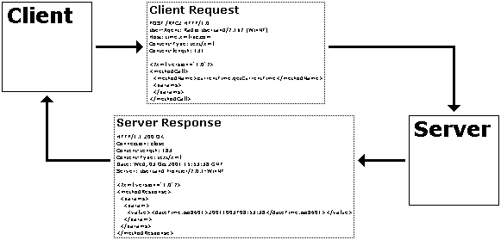
How XML-RPC works
A client performs an RPC by sending an HTTP request to a server that implements XML-RPC and receives the HTTP response
A call can have multiple parameters and one result
The protocol defines a few data types for the parameters and result

Slide 12
XML-RPC parts
XML-RPC data model
A set of types for use in passing parameters, return values, and faults (error messages)
XML-RPC request structures
An HTTP POST request containing method and parameter information
XML-RPC response structures
An HTTP response that contains return values or fault information

Slide 13
Data encoding rules
To exchange data, computers must agree on rules for encoding specific data types
Examples
two computers that process stock quotes need an agreed-upon rule for encoding float data types
two computers that process multiple stock quotes need an agreed-upon rule for encoding arrays

Slide 14
XML-RPC Data Model
6 basic data types
2 compound data types that represent combinations of types

Slide 15
Basic data types in XML-RPC

Slide 16
Complex data types in XML-RPC
Arrays
represent sequential information,
Structs
represent name-value pairs, much like hashtables, associative arrays, or properties

Slide 17
Representing basic types
All of the basic types are represented by simple XML elements whose content provides the value.
Example: to define a string whose value is "Hello World!":
<string>Hello World!</string>

Slide 18
Representing basic types
All of the basic types are represented by simple XML elements whose content provides the value.
Example: to define a string whose value is "Hello World!":
<string>Hello World!</string>

Slide 19
Complex data types in XML-RPC
Complete the sentences:
contain unordered content.
represent sequential information.
Arrays
Structs

Slide 20
Complex data types in XML-RPC
Complete the sentences:
Structs
contain unordered content.
Arrays
represent sequential information.

Slide 21
Complex data types in XML-RPC
Arrays
represent sequential information,
Structs
represent name-value pairs, much like hashtables, associative arrays, or properties

Slide 22
Representing arrays
Arrays are indicated by the array element, which contains a data element holding the list of values.

Slide 23
Representing arrays
Arrays are indicated by the array element, which contains a data element holding the list of values.

Slide 24
Representing arrays
Arrays are indicated by the array element, which contains a data element holding the list of values.

Slide 25
What data types are contained in this array?

Slide 26
What data types are contained in this array?

Slide 27
What data types are contained in this array?

Slide 28
What data types are contained in this array?

Slide 29
What data types are contained in this array?

Slide 30
Array

Slide 31
Multidimensional array

Slide 32
Complex data types in XML-RPC
Arrays
represent sequential information,
Structs
represent name-value pairs, much like hashtables, associative arrays, or properties

Slide 33
How many name-value pairs are represented in this struct?

Slide 34
How many name-value pairs are represented in this struct?

Slide 35
Where are the name-value pairs contained?

Slide 36
What element contains the name-value pairs?

Slide 37
Representing structs
Each struct element contains a list of member elements.
Member elements each contain one name element and one value element.
The order of members is not considered important.

Slide 38
Representing structs
Each struct element contains a list of member elements.
Member elements each contain one name element and one value element.
The order of members is not considered important.

Slide 39
What data types are contained in this struct?

Slide 40
What data types are contained in this struct?

Slide 41
What data types are contained in this struct?

Slide 42
What data types are contained in this struct?
Let’s first identify how many members are contained in this struct

Slide 43
What data types are contained in this struct?
Let’s first identify how many members are contained in this struct

Slide 44
What data types are contained in this struct?
We will now examine each member separately

Slide 45
What data types are contained in this struct?
We will now examine each member separately

Slide 46
What data types are contained in this member?

Slide 47
This member contains one name-value pair, where the value is a string

Slide 48
What data types are contained in this struct?
Let’s move on to the next member

Slide 49
What data types are contained in this member?

Slide 50
This member of the struck contains one name-value pair,

Slide 51
This member of the struct contains one name-value pair, where the value is a struct

Slide 52
This member of the struct contains one name-value pair, where the value is a struct , which contains two string members

Slide 53
What data types are contained in this struct?
Let’s move on to the last member member

Slide 54
What data types are contained in this member?

Slide 55
What data types are contained in this member?

Slide 56
What data types are contained in this member?

Slide 57
Structs can also contain other structs, or even arrays.
For example, this struct contains a string, a struct, and an array

Slide 58
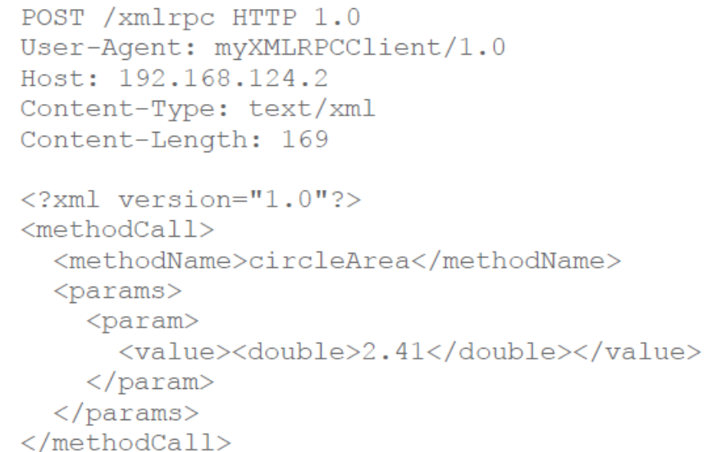
XML-RPC Request Structure
A combination of XML content and HTTP headers

Slide 59
XML-RPC Request Structure
A combination of
XML content
HTTP headers

Slide 60
XML-RPC Request Structure
A combination of
XML content
HTTP headers

Slide 61
XML-RPC Request Structure
root element is a methodCall element

Slide 62
XML-RPC Request Structure
each methodCall element contains a methodName element and a params element.

Slide 63
XML-RPC Request Structure
the methodName element identifies the name of the procedure to be called

Slide 64
XML-RPC Request Structure
the params element contains a list of parameters

Slide 65
XML-RPC Request Structure
param elements contain value elements

Slide 66
XML-RPC Request Structure
param elements contain value elements which identify the value of the parameter

Slide 67
XML-RPC Response Structure
If the response is successful - the procedure was found, executed correctly, and returned results - then the XML-RPC response will look much like a request, except that the methodCall element is replaced by a methodResponse element and there is no methodName element:

Slide 68
Fault response
If there was a problem in processing the XML-RPC request, the methodResponse element will contain a fault element instead of a params element. The fault element, like the params element, has only a single value. Instead of containing a response to the request, however, that value indicates that something went wrong.

Slide 69
Criticism of XML-RPC
Critics argue that RPC calls can be made with plain XML instead
Both XML-RPC and XML require an application level data model (such as which filed names are defined in the XML schema or the parameter names in XML-RPC)
XML-RPC uses about 4 times the number of bytes compared to plain XML to encode the same objects
Does XML-RPC add any value?

Slide 70

Open Question
Points: 10
Does XML-RPC add any value?
Answer

Slide 71
Benefits of XML-RPC
Well defined protocol
Grater support from libraries
Many available implementations
You don’t have to write as much code
...

Slide 72
Connecting disparate systems – how (1)
XML – data format, not a protocol
Flexibility
Cross-platform usability
XML over HTTP POST request
Sender assembles XML document and sends it much like HTML from data
Recipient processes the XML and sends back the response, also in XML
Developers need to create custom vocabularies for these transactions

Slide 73
Connecting disparate systems – how (2)
Use standardized vocabularies
XML-RPC
A very simple protocol, uses XML messages travelling on HTTP to represent client-server remote procedure call (RPC)
XML messages identify methods, parameters, and the results for calling the methods
XML documents use simple but effective set of data types to pass information between computers
SOAP
Details in Module 2

Slide 74
Connecting disparate systems – how (3)
REST
HTTP-based alternative
BEEP
Uses XML to build protocols on TCP sockets
Supports HTTP-style message-and-reply
SOAP messages can be transmitted over BEEP

Slide 75
Open Question
Points: 10
What is the relationship between XML, XML-RPC, and SOAP?
Open Question is only supported on Version 2.0 or newer.
Answer

Slide 76
What is the relationship between XML, XML-RPC, and SOAP?
Searching / Publishing Web Services
Discovery UDDI
Description WSDL
Describing Web Services interface
XML Messaging XML-RPC, SOAP,XML
Transport HTTP,SMTP,FTP, BEEP
Encoding messages in XML format
Transporting XML messages between client and server
76

Slide 77
Guided questions for Module 1
What is a service?
What is a web-service?
What is a web-service protocol stack?
What is XML messaging?
What is service description?
What is service discovery?
What is XML-RPC
What is XML?
What is SOAP?
What is WSDL?
What is UDDI?

Slide 78
Guided questions for Module 1
What is the relationship between XML, XML-RPC, and SOAP?
What is the relationship between SOAP, WSDL, and UDDI?
What is the relationship between WSDL and service description?
What is the relationship between UDDI and service discovery?
What are the three main actors in service architecture?
What are the steps in a typical development plan for a service requestor?
How do we develop web services from the service provider perspective?

Slide 79
Guided questions for Module 1
Why do we use XML-RPC when developing services? What are its advantages?
What is “glue code” and how do we use XML-RPC as glue code?
How do we publish services with XML-RPC?
Combination of what three parts define a complete RPC?
What data types are defined in XML-RPC specification and how are they represented?
What elements are in XML-RPC request?
What elements are in XML-RPC response?
How developer uses XML-RPC?

Slide 80
Module 1 Summary
Concept of “service oriented” and the background of service computing
Web Services architecture
Web service actors and their roles
Web service protocol stack
Basics of XML-RPC technology

